Slide 1
CSD3009 -
DATA STRUCTURES AND ANALYSIS OF ALGORITHMS
DR.S.DEVARAJU

Slide 2
Module 4
Searching and Sorting: Searching: Linear search, Binary search and Hashing. Algorithms and data structures for sorting: Insertion Sort, Bubble sort, Selection Sort, Merge sort, Quick Sort, Heap sort, Radix sort, Bucket sort. Algorithm design techniques: Divide and conquer, Greedy approach, dynamic programming.
https://www.javatpoint.com/data-structure-tutorial

Slide 3
Searching Techniques

Slide 4
The searching problem
Searching is a process of finding a particular element among several given elements.
The search is successful if the required element is found. Otherwise, the search is unsuccessful.
    (OR)
    Problem is to retrieve an entire record based on the value of some key
    Find an index i such that x Si if x equals one of the keys
    If x does not equal one of the keys, report failure

Slide 5
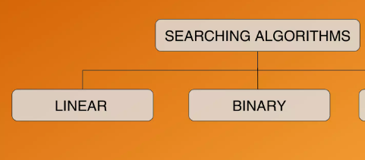
The searching problem
Searching algorithm is an algorithm made up of a series of instructions that retrieves information stored within some data structure, or calculated in the search space of the problem domain.

Slide 6
Linear Search
https://www.youtube.com/watch?v=9J5OTuk2_CI

Slide 7
Sequential Search with Arrays

Slide 8
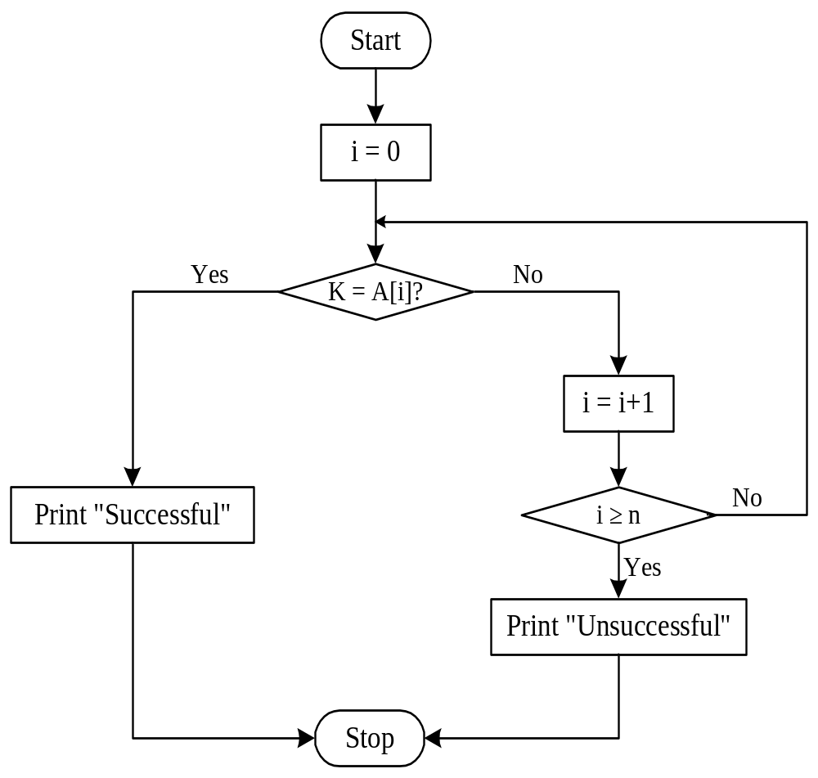
Flowchart: Sequential Search with Array

Slide 9
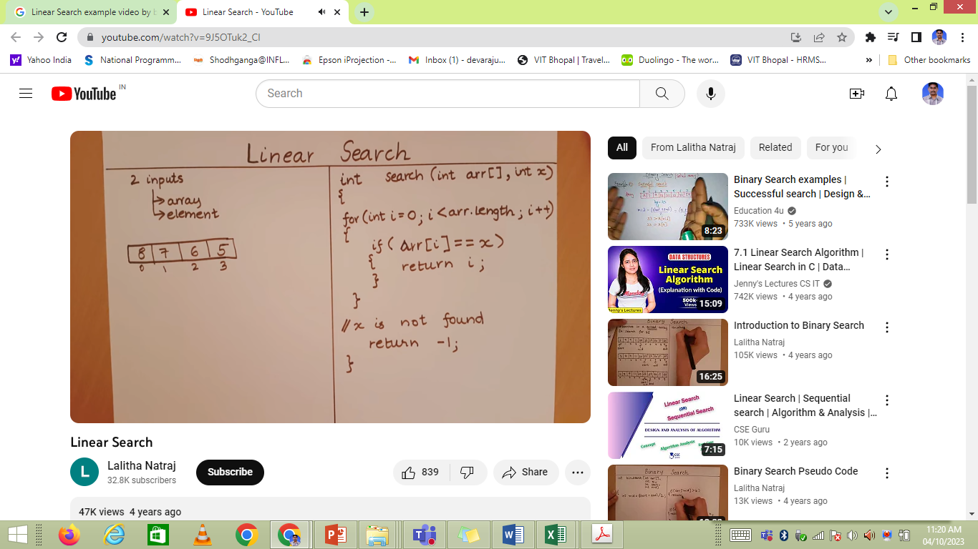
Example: Sequential Search with Array

Slide 10
Example: Sequential Search with Array
int main()
{
int A[10], i, n, K, flag = 0;
printf("Enter the size of an array: ");
scanf("%d",&n);
printf("Enter the elements of the array: ");
for(i=0; i < n; i++)
scanf("%d",&A[i]);
printf("Enter the number to be searched: ");
scanf("%d",&K);
for(i=0;i<n;i++){
if(a[i] == K){
flag = 1; break;
}
}
if(flag == 0)
printf("The number is not in the list");
else
printf("The number is found at index %d",i);
return 0;
}

Slide 11
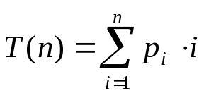
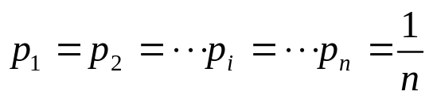
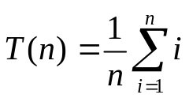
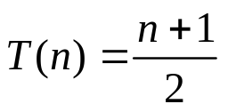
Complexity Analysis
Case 1: The key matches with the first element
  T(n) = 1
Case 2: Key does not exist
  T(n) = n
Case 3: The key is present at any location in the array

Slide 12
Complexity Analysis : Summary
Case | Number of key comparisons | Asymptotic complexity | Remark
Case 1 | T(n) = 1 | T(n) = O(1) | Best case
Case 2 | T(n) = n | T(n) = O(n) | Worst case
Case 3 |  | T(n) = O(n) | Average case

Slide 13
Binary Search
https://www.youtube.com/watch?v=81QLBCW94Oo

Slide 14

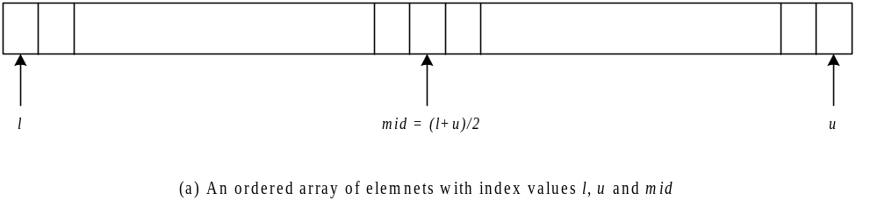
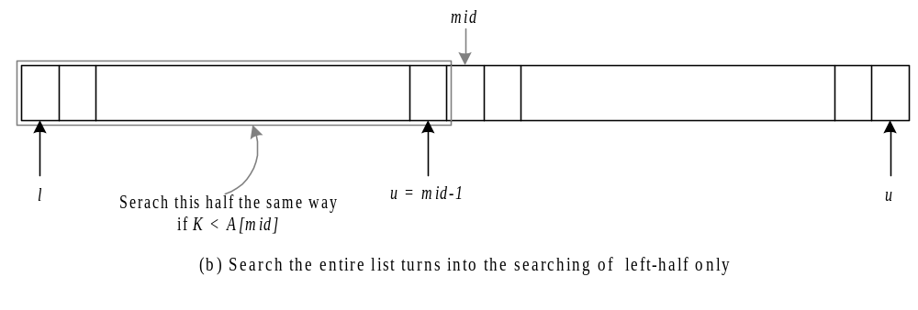
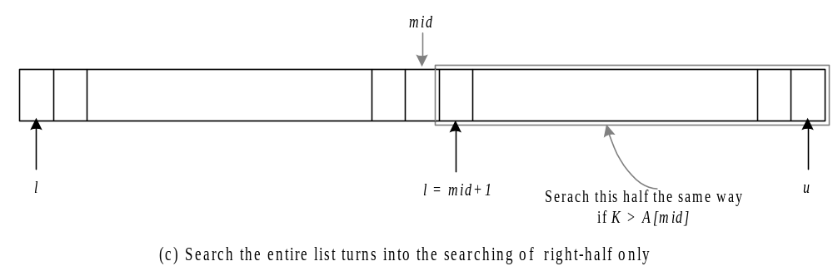

Slide 15
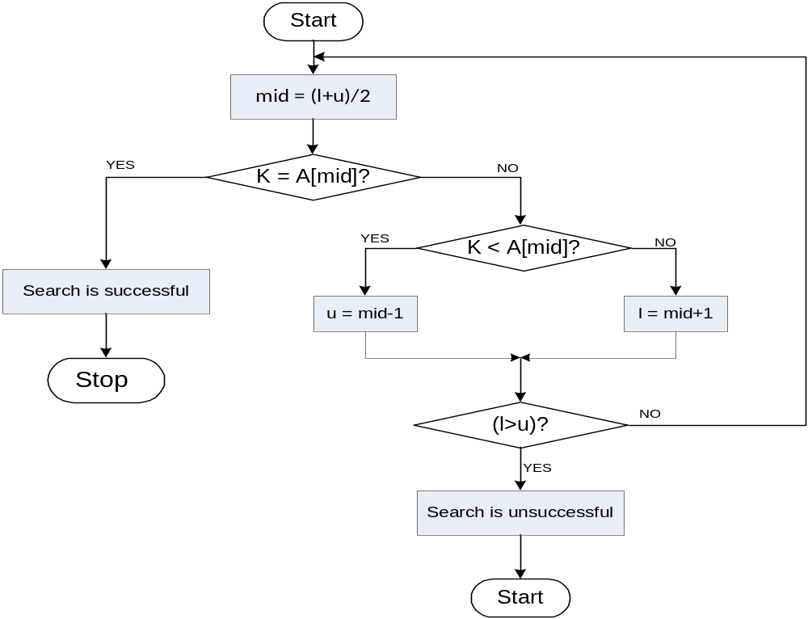
Flowchart: Binary Search with Array

Slide 16
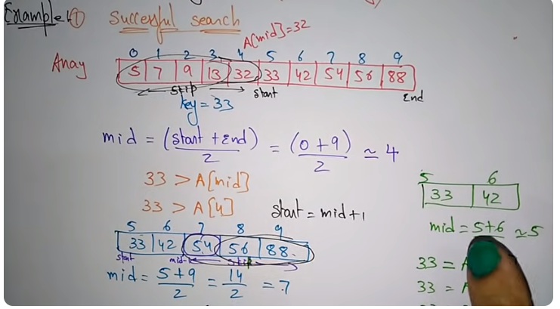
Binary Search (with Iteration)
33 < A[mid]
33 < A[7]
end = mid -1
33 = A[mid]
33 = A[7]
33 = 33

Slide 17
Binary Search (with Iteration)
#include <stdio.h>
int main()
{
int i, l, u, mid, n, K, data[100];
printf("Enter number of elements\n");
scanf("%d",&n);
printf("Enter %d integers in sorted order\n", n);
for (i = 0; i < n; i++)
scanf("%d",&array[i]);
printf("Enter value to find\n");
scanf("%d", &K);
l = 0;
u = n - 1;
mid = (l+u)/2;
Contd…

Slide 18
Binary Search (with Iteration)
while (l <= u) {
if (data[mid] < K)
l = mid + 1;
else if (data[mid] == K) {
printf("%d found at location %d.\n", search, mid+1);
break;
}
else
u = mid - 1;
mid = (l + u)/2;
}
if (l > u)
printf("Not found! %d is not present in the list.\n", K);
return 0;
}

Slide 19
Binary Search (with Recursion)
#include<stdio.h>
int main(){
int data[100],i, n, K, flag, l, u;
printf("Enter the size of an array: ");
scanf("%d",&n);
printf("Enter the elements of the array in sorted order: " );
for(i=0;i<n;i++)
scanf("%d",&a[i]);
printf("Enter the number to be search: ");
scanf("%d",&K);
l=0,u=n-1;
flag = binarySearch(data,n,K,l,u);
if(flag==0)
printf("Number is not found.");
else
printf("Number is found.");
return 0;
}
Contd…

Slide 20
Binary Search (with Recursion)
int binary(int a[],int n,int K,int l,int u){
int mid;
if(l<=u){
mid=(l+u)/2;
if(K==a[mid]){
return(1);
}
else if(m<a[mid]){
return binarySearch(a,n,K,l,mid-1);
}
else
return binarySearch(a,n,m,mid+1,u);
}
else return(0);
}

Slide 21

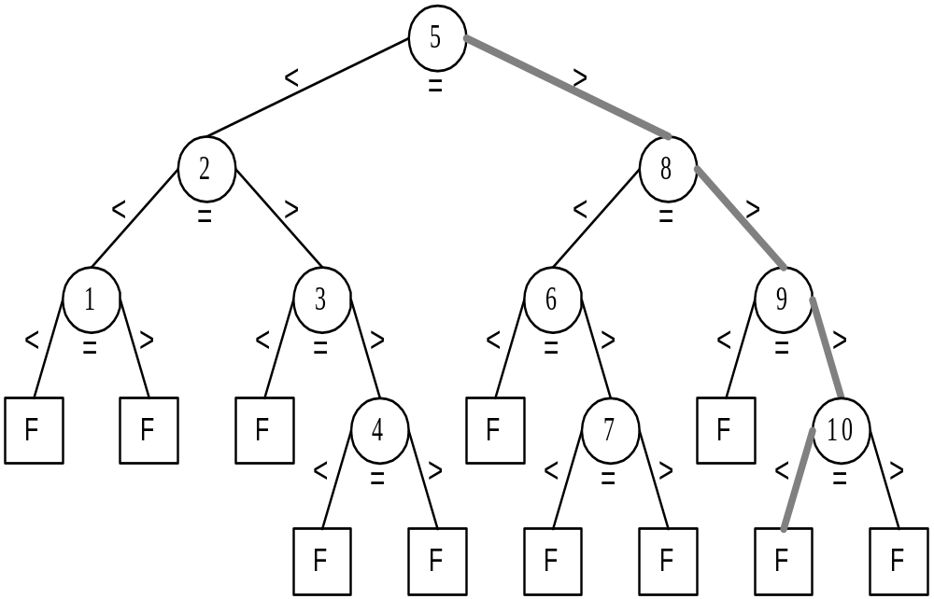

Slide 22




Let n be the total number of elements in the list under search and there exist an integer k such that:-
For successful search:-
  If , then the binary search algorithm requires at least one comparison and at most k comparisons.
For unsuccessful search:-
  If , then the binary search algorithm requires k comparisons.
  If , then the binary search algorithm requires either k-1 or k number of comparisons.

Slide 23

Best case
  T(n) = 1
Worst case
  T(n) =

Slide 24
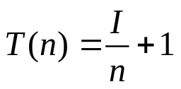
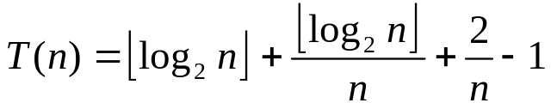
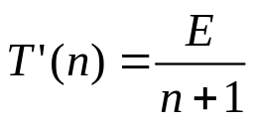
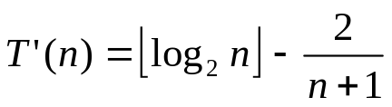
Average Case
  Successful search:-
  Unsuccessful search:-

Slide 25


Slide 26

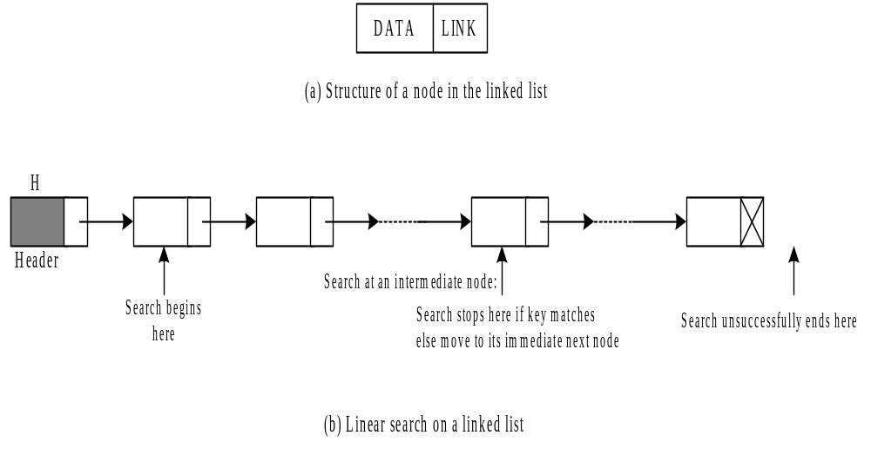

Slide 27

Start
temp = header
while
temp != NULL
Print Unsuccessful
temp = temp->next
T
N
temp->data == key
Y
Print Success
Return temp

Slide 28
Example: Sequential Search with LL
#include <stdio.h>
#include <stdlib.h>
struct node
{
int data;
struct node *next;
};
int main()
{
struct node *header = NULL;
int K, n;
printf("Enter the number of nodes: ");
scanf("%d", &n);
printf("\nDisplaying the list\n");
generate(header, num);
printf("\nEnter key to search: ");
scanf("%d", &key);
searchBinary(header, K);
delete(header);
return 0;
}

Slide 29
Example: Linear Search with LL
void generate(struct node *head, int n)
{
int i;
struct node *temp;
for (i = 0; i < num; i++)
{
temp = (struct node *)malloc(sizeof(struct node));
temp->data = rand() % n;
if (*header == NULL)
{
*header = temp;
temp->next = NULL;
}
else
{
temp->next = header;
header = temp;
}
printf("%d ", temp->data);
}
}

Slide 30
Example: Linear Search with LL
void searchBinary(struct node *temp, int K)
{
while (temp != NULL) {
if (temp->data == K) {
printf("key found\n");
return;
}
else temp = temp->next;
}
printf("Key not found\n");
}
void delete(struct node *header) {
struct node *temp;
temp = header;
while (temp != NULL) {
temp = temp->next;
free(header);
header = temp;
}
}

Slide 31
Complexity Analysis
Case | Number of key comparisons | Asymptotic complexity | Remark
Case 1 | T(n) = 1 | T(n) = O(1) | Best case
Case 2 |  | T(n) = O(n) | Average case
Case 3 | T(n) = n | T(n) = O(n) | Worst case

Slide 32
Sorting
https://www.youtube.com/watch?v=TnU8C-OKcZs

Slide 33
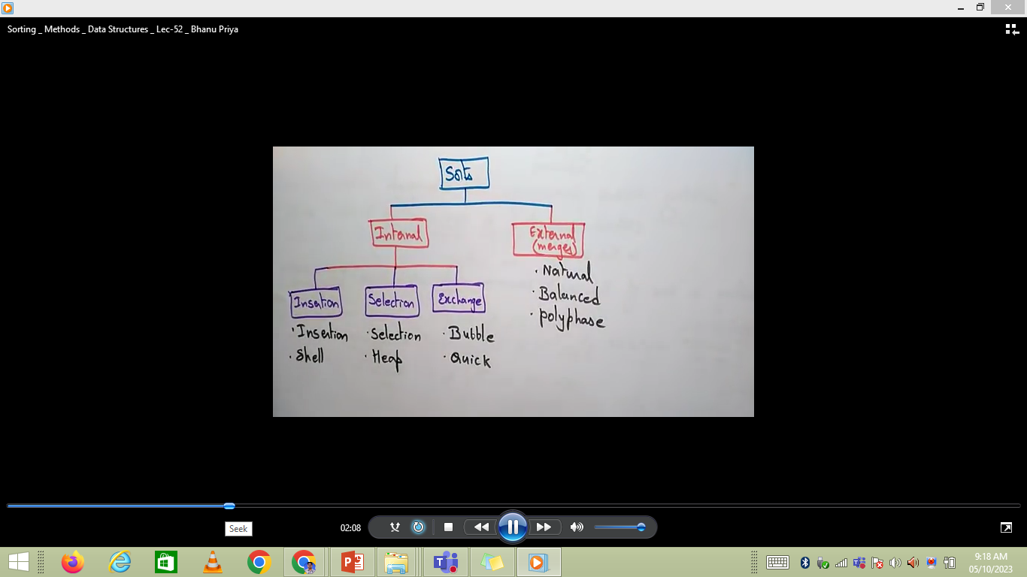
What is Sorting?

Slide 34
What is Sorting?
  Sorting: an operation that segregates items into groups according to specified criterion.
  A = { 3 1 6 2 1 3 4 5 9 0 }
  A = { 0 1 1 2 3 3 4 5 6 9 }

Slide 35
Why Sort and Examples
Consider:
Sorting Books in Library (Dewey system)
Sorting Individuals by Height (Feet and Inches)
Sorting Movies in Blockbuster (Alphabetical)
Sorting Numbers (Sequential)

Slide 36
Sorting
Sorting is a process in which records are arranged in ascending or descending order
1 2 3 4 5 6
77
42
35
12
101
5
1 2 3 4 5 6
5
12
35
42
77
101

Slide 37
Types of sorting
There are many, many different types of sorting algorithms, but the primary ones are:
Selection sort (https://www.youtube.com/watch?v=EcYWIYfGiAI)
Insertion sort (https://www.youtube.com/watch?v=4MU_yl6957E)
Bubble sort (https://www.youtube.com/watch?v=VRL2iwrCm8E)
Merge sort (https://www.youtube.com/watch?v=eGO_FMca7mk)
Quick sort (https://www.youtube.com/watch?v=cYhlWJHRR0I & https://www.youtube.com/watch?v=JFNjj7jrvuo)
Heap sort (https://www.youtube.com/watch?v=yAlOKmgq8do & https://www.youtube.com/watch?v=VLLJ6vUQUMY)
Radix sort (https://www.youtube.com/watch?v=XcF1l2pq9ZI)
Bucket sort (https://www.youtube.com/watch?v=geVyIsFpxUs) & https://www.youtube.com/watch?v=geVyIsFpxUs

Slide 38
Selection Sort

Slide 39
Selection Sort
Selection sort is a sorting algorithm which works as follows:
  Find the minimum value in the list
  Swap it with the value in the first position
  Repeat the steps above for remainder of the list (starting at the second position)

Slide 40
Example: Selection Sort
26 33 43 100 46 88 52 17 53 77
17 | 33 43 100 46 88 52 26 53 77
17 26 | 43 100 46 88 52 33 53 77
17 26 33 | 100 46 88 52 43 53 77
17 26 33 43 | 46 88 52 100 53 77
17 26 33 43 46 | 88 52 100 53 77
17 26 33 43 46 52 | 88 100 53 77
17 26 33 43 46 52 53 | 100 88 77
17 26 33 43 46 52 53 77 | 88 100
17 26 33 43 46 52 53 77 88 | 100

Slide 41
Selection Sort
void selectionSort(int numbers[], int array_size) {
int i, j, T, min, count;
for (i = 0; i < array_size; i++) {
min = i;
for (j = i + 1; j < array_size; j++) {
if (numbers[j] < numbers[min]) {
min = j; }
}
T = numbers[min];
numbers[min] = numbers[i];
numbers[i] = T;
}
}

Slide 42
Time Complexity of Selection Sort
The total number of comparisons is :-
(N-1)+(N-2)+(N-3)+………… +1= N(N-1)/2
We can ignore the constant 1/2
We can express N(N-1) as N² – N
We can ignore N as well since N² grows more rapidly than N, making our algorithm O(N²)

Slide 43
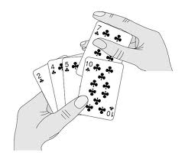
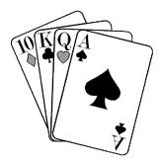
Insertion Sort

Slide 44
Insertion Sort
In insertion sort, each successive element in the array to be sorted is inserted into its proper place with respect to the other, already sorted elements.
We divide our array in a sorted and an unsorted array
Initially the sorted portion contains only one element: the first element in the array.
We take the second element in the array, and put it into its correct place

Slide 45
Insertion Sort
That is, array[0] and array[1] are in order with respect to each other.
Then the value in array[2] is put into its proper place, so array [0]…. array[2] is sorted and so on.
36
36
24
10
6
6
24
24
36
24
10
10
10
10
10
36
24
12
6
6
6
6
36
24
12
12
12
12
12
36

Slide 46
Insertion Sort
Our strategy is to search for insertion point from the beginning of the array and shift the element down to make room for new element
We compare the item at array[current] to one before it, and swap if it is less.
We then compare array[current-1] to one before it and swap if necessary.

Slide 47
Example: Insertion Sort
99 | 55 4 66 28 31 36 52 38 72
55 99 | 4 66 28 31 36 52 38 72
4 55 99 | 66 28 31 36 52 38 72
4 55 66 99 | 28 31 36 52 38 72
4 28 55 66 99 | 31 36 52 38 72
4 28 31 55 66 99 | 36 52 38 72
4 28 31 36 55 66 99 | 52 38 72
4 28 31 36 52 55 66 99 | 38 72
4 28 31 36 38 52 55 66 99 | 72
4 28 31 36 38 52 55 66 72 99 |

Slide 48
Insertion Sort Algorithm
void insertionSort(int array[], int length)
{
int i, j, value;
for(i = 1; i < length; i++)
{
value = a[i];
for (j = i - 1; j >= 0 && a[ j ] > value; j--)
{
a[j + 1] = a[ j ];
}
a[j + 1] = value;
}
}

Slide 49
Bubble Sort

Slide 50
Bubble Sort
Bubble sort is similar to selection sort in the sense that it repeatedly finds the largest/smallest value in the unprocessed portion of the array and puts it back.
However, finding the largest value is not done by selection this time.
We "bubble" up the largest value instead.

Slide 51
Bubble Sort
Compares adjacent items and exchanges them if they are out of order.
Comprises of several passes.
In one pass, the largest value has been “bubbled” to its proper position.
In second pass, the last value does not need to be compared.

Slide 52
Bubble Sort
Traverse a collection of elements
  Move from the front to the end
  “Bubble” the largest value to the end using pair-wise comparisons and swapping
1 2 3 4 5 6
77
42
35
12
101
5

Slide 53
Bubble Sort
Traverse a collection of elements
  Move from the front to the end
  “Bubble” the largest value to the end using pair-wise comparisons and swapping
Swap
1 2 3 4 5 6
42
77
77
42
35
12
101
5

Slide 54
Bubble Sort
Traverse a collection of elements
  Move from the front to the end
  “Bubble” the largest value to the end using pair-wise comparisons and swapping
1 2 3 4 5 6
Swap
35
77
42
77
35
12
101
5

Slide 55
Bubble Sort
Traverse a collection of elements
  Move from the front to the end
  “Bubble” the largest value to the end using pair-wise comparisons and swapping
1 2 3 4 5 6
Swap
12
77
42
35
77
12
101
5

Slide 56
Bubble Sort
Traverse a collection of elements
  Move from the front to the end
  “Bubble” the largest value to the end using pair-wise comparisons and swapping
1 2 3 4 5 6
42
35
12
77
101
5
No need to swap

Slide 57
Bubble Sort
Traverse a collection of elements
  Move from the front to the end
  “Bubble” the largest value to the end using pair-wise comparisons and swapping
1 2 3 4 5 6
Swap
5
101
42
35
12
77
101
5

Slide 58
Bubble Sort
Traverse a collection of elements
  Move from the front to the end
  “Bubble” the largest value to the end using pair-wise comparisons and swapping
1 2 3 4 5 6
101
42
35
12
77
5
Largest value correctly placed

Slide 59
Items of Interest
Notice that only the largest value is correctly placed
All other values are still out of order
So we need to repeat this process
1 2 3 4 5 6
101
42
35
12
77
5
Largest value correctly placed

Slide 60
Repeat “Bubble Up” How Many Times?
If we have N elements…
And if each time we bubble an element, we place it in its correct location…
Then we repeat the “bubble up” process N – 1 times.
This guarantees we’ll correctly place all N elements.

Slide 61
“Bubbling” All the Elements
1 2 3 4 5 6
42
35
12
77
5
101
1 2 3 4 5 6
35
12
42
5
77
101
1 2 3 4 5 6
N - 1
12
35
5
42
77
101
1 2 3 4 5 6
12
5
35
42
77
101
1 2 3 4 5 6
5
12
35
42
77
101

Slide 62
Reducing the Number of Comparisons
1 2 3 4 5 6
77
42
35
12
101
5
1 2 3 4 5 6
42
35
12
77
5
101
1 2 3 4 5 6
35
12
42
5
77
101
1 2 3 4 5 6
12
35
5
42
77
101
1 2 3 4 5 6
12
5
35
42
77
101

Slide 63
Already Sorted Collections?
What if the collection was already sorted?
What if only a few elements were out of place and after a couple of “bubble ups,” the collection was sorted?
We want to be able to detect this and “stop early”!
1 2 3 4 5 6
5
12
35
42
77
101

Slide 64
Using a Boolean “Flag”
We can use a boolean variable to determine if any swapping occurred during the “bubble up.”
If no swapping occurred, then we know that the collection is already sorted!
This boolean “flag” needs to be reset after each “bubble up.”

Slide 65
Bubble Sort Algorithm
void bubbleSort (int S[ ], int length) {
bool isSorted = false;
while(!isSorted)
{
isSorted = true;
for(int i = 0; i<length; i++)
{
if(S[i] > S[i+1])
{
int temp = S[i];
S[i] = S[i+1];
S[i+1] = temp;
isSorted = false;
}
}
length--;
}
}

Slide 66
Summary
The insertion sort is a good middle-of-the-road choice for sorting lists of a few thousand items or less.
The insertion sort is over twice as fast as the bubble sort and almost 40% faster than the selection sort. The insertion sort shouldn't be used for sorting lists larger than a couple thousand items or repetitive sorting of lists larger than a couple hundred items.

Slide 67
Mergesort

Slide 68
Divide and Conquer
Divide and Conquer cuts the problem in half each time, but uses the result of both halves:
  cut the problem in half until the problem is trivial
  solve for both halves
  combine the solutions

Slide 69
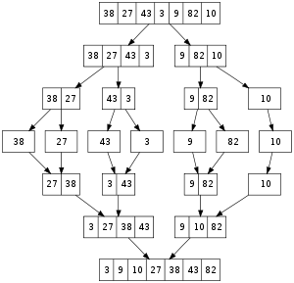
Merge Sort

Slide 70
Mergesort
A divide-and-conquer algorithm:
Divide the unsorted array into 2 halves until the sub-arrays only contain one element
Merge the sub-problem solutions together:
  Compare the sub-array’s first elements
  Remove the smallest element and put it into the result array
  Continue the process until all elements have been put into the result array
37
23
6
89
15
12
2
19

Slide 71
98
23
45
14
6
67
33
42

Slide 72
98
23
45
14
6
67
33
42
98
23
45
14
6
67
33
42

Slide 73
98
23
45
14
6
67
33
42
98
23
45
14
6
67
33
42
98
23
45
14

Slide 74
98
23
45
14
6
67
33
42
98
23
45
14
6
67
33
42
98
23
45
14
98
23

Slide 75
98
23
45
14
6
67
33
42
98
23
45
14
6
67
33
42
98
23
45
14
98
23
Merge

Slide 76
98
23
45
14
6
67
33
42
98
23
45
14
6
67
33
42
98
23
45
14
98
23
23
Merge

Slide 77
98
23
45
14
6
67
33
42
98
23
45
14
6
67
33
42
98
23
45
14
98
23
23
98
Merge

Slide 78
98
23
45
14
6
67
33
42
98
23
45
14
6
67
33
42
98
23
45
14
98
23
45
14
23
98

Slide 79
98
23
45
14
6
67
33
42
98
23
45
14
6
67
33
42
98
23
45
14
98
23
45
14
23
98
Merge

Slide 80
98
23
45
14
6
67
33
42
98
23
45
14
6
67
33
42
98
23
45
14
98
23
45
14
23
98
14
Merge

Slide 81
98
23
45
14
6
67
33
42
98
23
45
14
6
67
33
42
98
23
45
14
98
23
45
14
23
98
14
45
Merge

Slide 82
98
23
45
14
6
67
33
42
98
23
45
14
6
67
33
42
98
23
45
14
98
23
45
14
23
98
14
45
Merge

Slide 83
98
23
45
14
6
67
33
42
98
23
45
14
6
67
33
42
98
23
45
14
98
23
45
14
23
98
14
45
14
Merge

Slide 84
98
23
45
14
6
67
33
42
98
23
45
14
6
67
33
42
98
23
45
14
98
23
45
14
23
98
14
45
14
23
Merge

Slide 85
98
23
45
14
6
67
33
42
98
23
45
14
6
67
33
42
98
23
45
14
98
23
45
14
23
98
14
45
14
23
45
Merge

Slide 86
98
23
45
14
6
67
33
42
98
23
45
14
6
67
33
42
98
23
45
14
98
23
45
14
23
98
14
45
14
23
45
98
Merge

Slide 87
98
23
45
14
6
67
33
42
98
23
45
14
6
67
33
42
98
23
45
14
6
67
33
42
98
23
45
14
23
98
14
45
14
23
45
98

Slide 88
98
23
45
14
6
67
33
42
98
23
45
14
6
67
33
42
98
23
45
14
6
67
33
42
98
23
45
14
6
67
23
98
14
45
14
23
45
98

Slide 89
98
23
45
14
6
67
33
42
98
23
45
14
6
67
33
42
98
23
45
14
6
67
33
42
98
23
45
14
6
67
23
98
14
45
14
23
45
98
Merge

Slide 90
98
23
45
14
6
67
33
42
98
23
45
14
6
67
33
42
98
23
45
14
6
67
33
42
98
23
45
14
6
67
23
98
14
45
6
14
23
45
98
Merge

Slide 91
98
23
45
14
6
67
33
42
98
23
45
14
6
67
33
42
98
23
45
14
6
67
33
42
98
23
45
14
6
67
23
98
14
45
6
67
14
23
45
98
Merge

Slide 92
98
23
45
14
6
67
33
42
98
23
45
14
6
67
33
42
98
23
45
14
6
67
33
42
98
23
45
14
6
67
33
42
23
98
14
45
6
67
14
23
45
98

Slide 93
98
23
45
14
6
67
33
42
98
23
45
14
6
67
33
42
98
23
45
14
6
67
33
42
98
23
45
14
6
67
33
42
23
98
14
45
6
67
14
23
45
98
Merge

Slide 94
98
23
45
14
6
67
33
42
98
23
45
14
6
67
33
42
98
23
45
14
6
67
33
42
98
23
45
14
6
67
33
42
23
98
14
45
6
67
33
14
23
45
98
Merge

Slide 95
98
23
45
14
6
67
33
42
98
23
45
14
6
67
33
42
98
23
45
14
6
67
33
42
98
23
45
14
6
67
33
42
23
98
14
45
6
67
33
42
14
23
45
98
Merge

Slide 96
98
23
45
14
6
67
33
42
98
23
45
14
6
67
33
42
98
23
45
14
6
67
33
42
98
23
45
14
6
67
33
42
23
98
14
45
6
67
33
42
14
23
45
98
Merge

Slide 97
98
23
45
14
6
67
33
42
98
23
45
14
6
67
33
42
98
23
45
14
6
67
33
42
98
23
45
14
6
67
33
42
23
98
14
45
6
67
33
42
14
23
45
98
6
Merge

Slide 98
98
23
45
14
6
67
33
42
98
23
45
14
6
67
33
42
98
23
45
14
6
67
33
42
98
23
45
14
6
67
33
42
23
98
14
45
6
67
33
42
14
23
45
98
6
33
Merge

Slide 99
98
23
45
14
6
67
33
42
98
23
45
14
6
67
33
42
98
23
45
14
6
67
33
42
98
23
45
14
6
67
33
42
23
98
14
45
6
67
33
42
14
23
45
98
6
33
42
Merge

Slide 100
98
23
45
14
6
67
33
42
98
23
45
14
6
67
33
42
98
23
45
14
6
67
33
42
98
23
45
14
6
67
33
42
23
98
14
45
6
67
33
42
14
23
45
98
6
33
42
67
Merge

Slide 101
98
23
45
14
6
67
33
42
98
23
45
14
6
67
33
42
98
23
45
14
6
67
33
42
98
23
45
14
6
67
33
42
23
98
14
45
6
67
33
42
14
23
45
98
6
33
42
67
Merge

Slide 102
98
23
45
14
6
67
33
42
98
23
45
14
6
67
33
42
98
23
45
14
6
67
33
42
98
23
45
14
6
67
33
42
23
98
14
45
6
67
33
42
14
23
45
98
6
33
42
67
6
Merge

Slide 103
98
23
45
14
6
67
33
42
98
23
45
14
6
67
33
42
98
23
45
14
6
67
33
42
98
23
45
14
6
67
33
42
23
98
14
45
6
67
33
42
14
23
45
98
6
33
42
67
6
14
Merge

Slide 104
98
23
45
14
6
67
33
42
98
23
45
14
6
67
33
42
98
23
45
14
6
67
33
42
98
23
45
14
6
67
33
42
23
98
14
45
6
67
33
42
14
23
45
98
6
33
42
67
6
14
23
Merge

Slide 105
98
23
45
14
6
67
33
42
98
23
45
14
6
67
33
42
98
23
45
14
6
67
33
42
98
23
45
14
6
67
33
42
23
98
14
45
6
67
33
42
14
23
45
98
6
33
42
67
6
14
23
33
Merge

Slide 106
98
23
45
14
6
67
33
42
98
23
45
14
6
67
33
42
98
23
45
14
6
67
33
42
98
23
45
14
6
67
33
42
23
98
14
45
6
67
33
42
14
23
45
98
6
33
42
67
6
14
23
33
42
Merge

Slide 107
98
23
45
14
6
67
33
42
98
23
45
14
6
67
33
42
98
23
45
14
6
67
33
42
98
23
45
14
6
67
33
42
23
98
14
45
6
67
33
42
14
23
45
98
6
33
42
67
6
14
23
33
42
45
Merge

Slide 108
98
23
45
14
6
67
33
42
98
23
45
14
6
67
33
42
98
23
45
14
6
67
33
42
98
23
45
14
6
67
33
42
23
98
14
45
6
67
33
42
14
23
45
98
6
33
42
67
6
14
23
33
42
45
67
Merge

Slide 109
98
23
45
14
6
67
33
42
98
23
45
14
6
67
33
42
98
23
45
14
6
67
33
42
98
23
45
14
6
67
33
42
23
98
14
45
6
67
33
42
14
23
45
98
6
33
42
67
6
14
23
33
42
45
67
98
Merge

Slide 110
98
23
45
14
6
67
33
42
98
23
45
14
6
67
33
42
98
23
45
14
6
67
33
42
98
23
45
14
6
67
33
42
23
98
14
45
6
67
33
42
14
23
45
98
6
33
42
67
6
14
23
33
42
45
67
98

Slide 111
98
23
45
14
6
67
33
42
6
14
23
33
42
45
67
98

Slide 112
Algorithm
Mergesort(Passed an array)
if array size > 1
Divide array in half
Call Mergesort on first half.
Call Mergesort on second half.
Merge two halves.
Merge(Passed two arrays)
Compare leading element in each array
Select lower and place in new array.
(If one input array is empty then place
remainder of other array in output array)

Slide 113
Merge Sort
We don’t really pass in two arrays!
We pass in one array with indicator variables which tell us where one set of data starts and finishes and where the other set of data starts and finishes.
s1
f1
s2
f2

Slide 114
Merge Sort
void merge(int*,int*,int,int,int);
void mergesort(int *a, int*b, int low, int high) {
int pivot;
if(low<high) {
pivot=(low+high)/2;
mergesort(a,b,low,pivot);
mergesort(a,b,pivot+1,high);
merge(a,b,low,pivot,high);
}
}
int main() {
int a[] = {12,10,43,23,78,45,56,98,41,90,24};
int num; num = sizeof(a)/sizeof(int);
int b[num];
mergesort(a,b,0,num-1);
for(int i=0; i<num; i++) cout<<a[i]<<" "; cout<<endl; }

Slide 115
void merge(int *a, int *b, int low, int pivot, int high) {
int h,i,j,k; h=low; i=low; j=pivot+1;
while((h<=pivot)&&(j<=high)) {
if(a[h]<=a[j]) { b[i]=a[h]; h++; }
else { b[i]=a[j]; j++; }
i++; }
if(h>pivot) {
for(k=j; k<=high; k++) {
b[i]=a[k]; i++; } }
else {
for(k=h; k<=pivot; k++) {
b[i]=a[k]; i++; } }
for(k=low; k<=high; k++) a[k]=b[k]; }

Slide 116
Quicksort / partition-exchange sort
Quick sort is a divide and conquer algorithm.
Quick sort first divides a large list into two smaller sub-lists: the low elements and the high elements. Quick sort can then recursively sort the sub-lists.
The steps are:
1. Pick an element, called a pivot, from the list.
2. Reorder the list so that all elements with values less than the pivot come before the pivot, while all elements with values greater than the pivot come after it (equal values can go either way). After this partitioning, the pivot is in its final position. This is called the partition operation.
3. Recursively apply the above steps to the sub-list of elements with smaller values and separately the sub-list of elements with greater values.
The base case of the recursion are lists of size zero or one, which never need to be sorted.

Slide 117
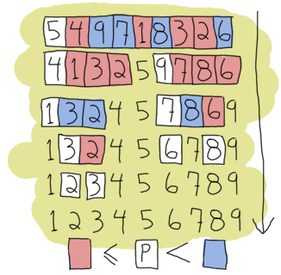
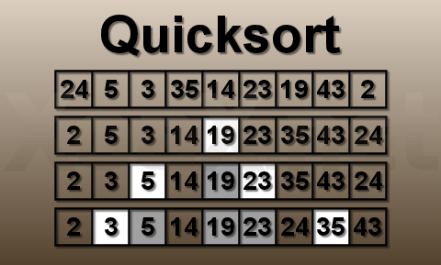
Quick Sort

Slide 118
Quick Sort
void quickSort(int a[], int first, int last);
int pivot(int a[], int first, int last);
void swap(int& a, int& b);
Void main()
{
int test[] = { 7, -13, 1, 3, 10, 5, 2, 4 };
int N = sizeof(test)/sizeof(int);
quickSort(test, 0, N-1);
}
void swap(int& a, int& b) {
int temp = a;
a = b;
b = temp;
}

Slide 119
void quickSort( int a[], int first, int last) {
int pivotElement;
if(first < last) {
pivotElement = pivot(a, first, last);
quickSort(a, first, pivotElement-1);
quickSort(a, pivotElement+1, last); }
}
int pivot(int a[], int first, int last){
int p = first;
int pivotElement = a[first];
for(int i = first+1 ; i <= last ; i++){
if(a[i] <= pivotElement){
p++;
swap(a[i], a[p]);
}
}
swap(a[p], a[first]);
return p;
}

Slide 120
int pivot(int a[], int first, int last){
int p = first;
int pivotElement = a[first];
for(int i = first+1 ; i <= last ; i++){
if(a[i] <= pivotElement){
p++;
swap(a[i], a[p]);
}
}
swap(a[p], a[first]);
return p;
}

Slide 121
Heap Sort

Slide 122
Array interpreted as a binary tree
Heap Sort
1 2 3 4 5 6 7 8 9 10
26 5 77 1 61 11 59 15 48 19
input file
[1]
26
[2]
5
[3]
77
[4]
1
[5]
61
[6]
11
[7]
59
[8]
15
[9]
48
[10]
19

Slide 123
Max heap following first for loop of heapsort
initial heap
[1]
77
[2]
61
[3]
59
exchange
[4]
48
[5]
19
[6]
11
[7]
26
[8]
15
[9]
1
[10]
5

Slide 124
Heap sort example
[1]
61
[2]
48
[3]
59
15
19
11
[7]
26
[4]
[5]
[6]
[8]
5
[9]
1
[10]
77
(a)
[1]
59
[2]
48
[3]
26
15
19
11
[7]
1
[4]
[5]
[6]
[8]
5
[9]
61
[10]
77
(b)

Slide 125
Heap sort example
[1]
48
[2]
19
[3]
26
15
5
11
[7]
1
[4]
[5]
[6]
59
59
61
[8]
[9]
61
[10]
77
(c)
[1]
26
[2]
19
[3]
11
48
15
5
1
[7]
48
[4]
[5]
[6]
59
[8]
59
[9]
61
[10]
77
(d)

Slide 126
Heap Sort
void adjust(element list[], int root, int n)
{
int child, rootkey; element temp;
temp=list[root]; rootkey=list[root].key;
child=2*root;
while (child <= n) {
if ((child < n) &&
(list[child].key < list[child+1].key))
child++;
if (rootkey > list[child].key) break;
else {
list[child/2] = list[child];
child *= 2;
}
}
list[child/2] = temp;
}
i
2i
2i+1

Slide 127
Heap Sort
void heapsort(element list[], int n)
{
int i, j;
element temp;
for (i=n/2; i>0; i--) adjust(list, i, n);
for (i=n-1; i>0; i--) {
SWAP(list[1], list[i+1], temp);
adjust(list, 1, i);
}
}
ascending order (max heap)
bottom-up
n-1 cylces
top-down

Slide 128
Radix Sort

Slide 129
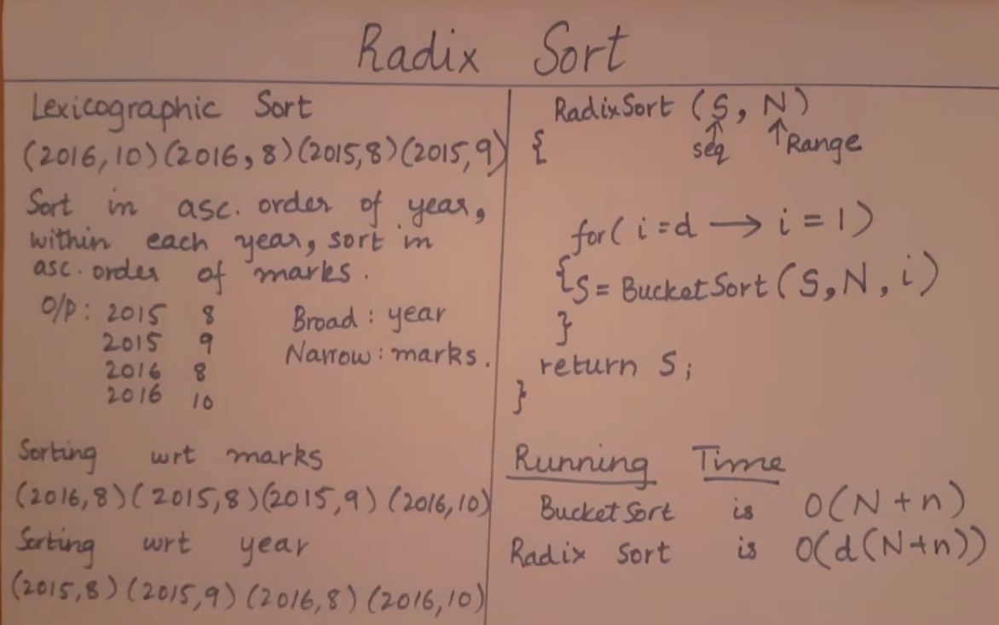
Radix Sort
https://www.youtube.com/watch?v=XcF1l2pq9ZI

Slide 130
Radix Sort
Sort by keys
K⁰, K¹, …, K^{r-1}
Most significant key
Least significant key
R₀, R₁, …, R_{n-1} are said to be sorted w.r.t. K₀, K₁, …, K_{r-1} iff
0≤i<n-1
Most significant digit first: sort on K⁰, then K¹, ...
Least significant digit first: sort on K^{r-1}, then K^{r-2}, ...

Slide 131
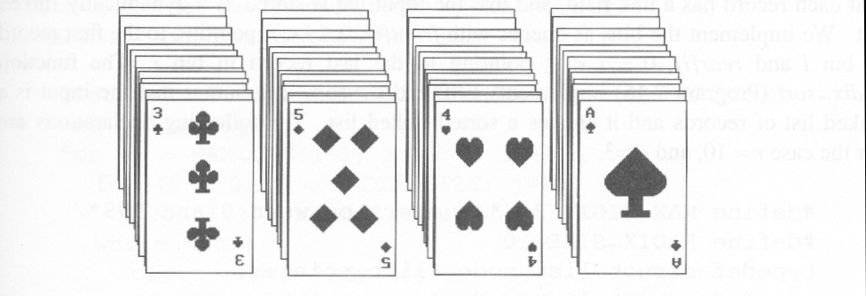
Arrangement of cards after first pass of an MSD sort
Suits: ♣ < ♦ < ♥ < ♠
Face values: 2 < 3 < 4 < … < J < Q < K < A
(1) MSD sort first, e.g., bin sort, four bins ♣ ♦ ♥ ♠
LSD sort second, e.g., insertion sort
(2) LSD sort first, e.g., bin sort, 13 bins
2, 3, 4, …, 10, J, Q, K, A
MSD sort, e.g., bin sort four bins ♣ ♦ ♥ ♠

Slide 132
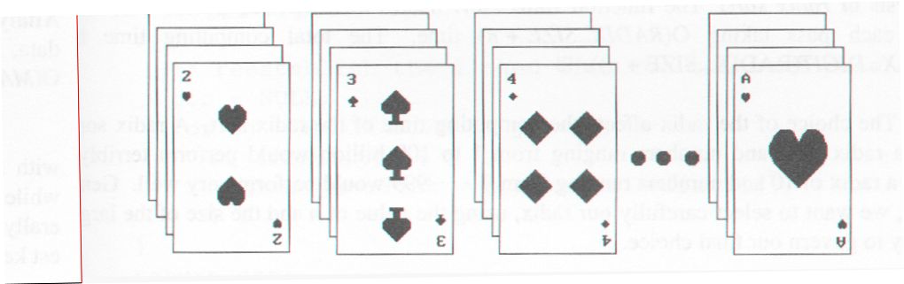
Arrangement of cards after first pass of LSD sort

Slide 133
Radix Sort
0 ≤ K ≤ 999
(K⁰, K¹, K²)
MSD
LSD
0-9
0-9
0-9
radix 10 sort
radix 2 sort

Slide 134
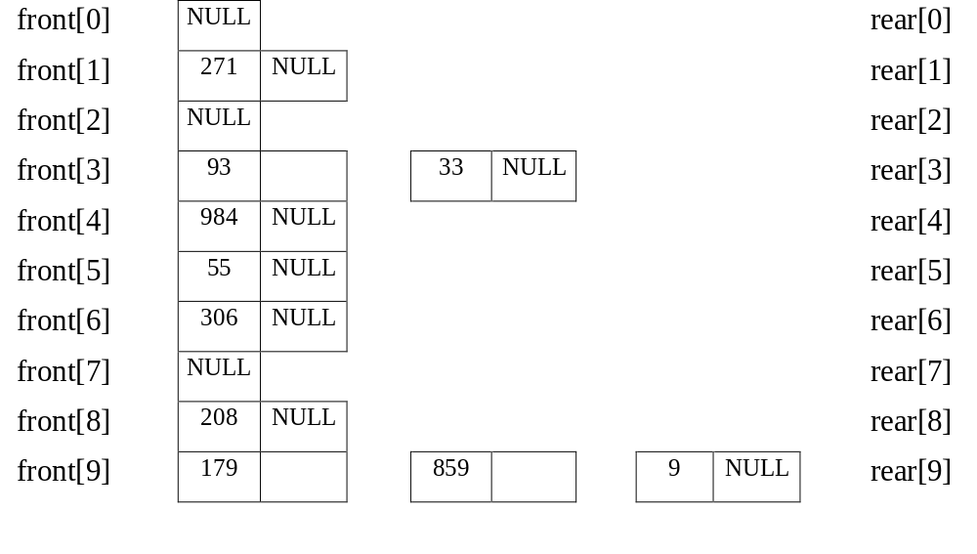
Example for LSD Radix Sort
d (digit) = 3, r (radix) = 10 ascending order
179, 208, 306, 93, 859, 984, 55, 9, 271, 33
Sort by digit
concatenate
271, 93, 33, 984, 55, 306, 208, 179, 859, 9 After the first pass

Slide 135
front[0]
306
208
9
null
rear[0]
front[1]
null
rear[1]
front[2]
null
rear[2]
front[3]
33
null
rear[3]
front[4]
null
rear[4]
front[5]
55
859
null
rear[5]
front[6]
null
rear[6]
front[7]
271
179
null
rear[7]
front[8]
984
null
rear[8]
front[9]
93
null
306, 208, 9, 33, 55, 859, 271, 179, 984, 93 (second pass)
rear[9]

Slide 136
front[0]
9
33
55
93
null
rear[0]
front[1]
179
null
rear[1]
front[2]
208
271
null
rear[2]
front[3]
306
null
rear[3]
front[4]
null
rear[4]
front[5]
null
rear[5]
front[6]
null
rear[6]
front[7]
null
rear[7]
front[8]
859
null
rear[8]
front[9]
984
null
9, 33, 55, 93, 179, 208, 271, 306, 859, 984 (third pass)
rear[9]

Slide 137
Data Structures for LSD Radix Sort
An LSD radix r sort,
R0, R1, ..., Rn-1 have the keys that are d-tuples
(x0, x1, ..., xd-1)
#define MAX_DIGIT 3
#define RADIX_SIZE 10
typedef struct list_node *list_pointer;
typedef struct list_node {
int key[MAX_DIGIT];
list_pointer link;
}

Slide 138
LSD Radix Sort
list_pointer radix_sort(list_pointer ptr)
{
list_pointer front[RADIX_SIZE],
rear[RADIX_SIZE];
int i, j, digit;
for (i=MAX_DIGIT-1; i>=0; i--) {
for (j=0; j<RADIX_SIZE; j++)
front[j]=read[j]=NULL;
while (ptr) {
digit=ptr->key[I];
if (!front[digit]) front[digit]=ptr;
else rear[digit]->link=ptr;
Initialize bins to be
empty queue.
Put records into queues.

Slide 139
O(n)
rear[digit]=ptr;
ptr=ptr->link;
}
/* reestablish the linked list for the next pass */
ptr= NULL;
for (j=RADIX_SIZE-1; j>=0; j++)
if (front[j]) {
rear[j]->link=ptr;
ptr=front[j];
}
}
return ptr;
}
Get next record.
O(d(n+r))
O(r)

Slide 140
Bucket sort

Slide 141
Bucket sort
bucket sort: A sort on integers in a known range where elements are "sorted" by tallying counts of occurrences of each unique value.
  For an input array a of integers from [0 .. M),
  create an array of counters C of size M.
  For each element in a, if its value is k, increment C[k].
  Use the counters in C to place a's contents back in sorted order.
  This sort can be even faster than quick sort!
    It takes advantage of additional information about the data,
    namely, that it is a collection of integers in a specific range.
    With some kinds of data, can be even more clever:
      if all values in a are unique, C can be boolean[] instead of int[]
      can use a BitSet to save memory (C will be smaller)

Slide 142
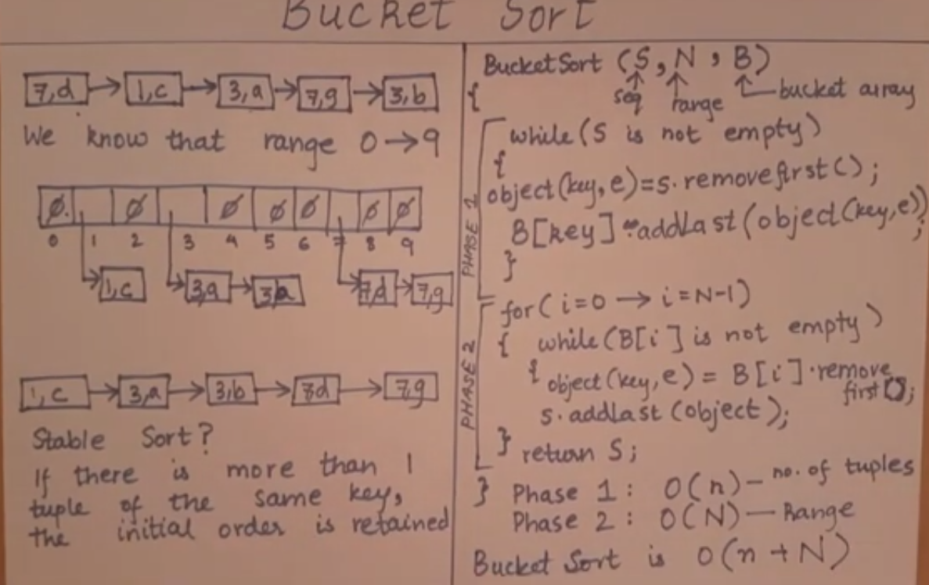

Bucket sort
https://www.youtube.com/watch?v=vfIoJMsqJ74

Slide 143
Bucket sort example
input array a:
create array of tallies:
use tallies to generate sorted contents of a
index | 0 | 1 | 2 | 3 | 4 | 5 | 6 | 7 | 8 | 9 | 10 | 11 | 12 | 13 | 14 | 15 | 16
value | 7 | 4 | 1 | 2 | 5 | 4 | 10 | 9 | 1 | 4 | 7 | 8 | 9 | 8 | 9 | 4 | 4
index | 0 | 1 | 2 | 3 | 4 | 5 | 6 | 7 | 8 | 9 | 10
value | 0 | 2 | 1 | 0 | 5 | 1 | 0 | 2 | 2 | 3 | 1
index | 0 | 1 | 2 | 3 | 4 | 5 | 6 | 7 | 8 | 9 | 10 | 11 | 12 | 13 | 14 | 15 | 16
value | 1 | 1 | 2 | 4 | 4 | 4 | 4 | 4 | 5 | 7 | 7 | 8 | 8 | 9 | 9 | 9 | 10

Slide 144
Bucket sort code
// Sorts the contents of a using bucket sort algorithm.
// Precondition: all elements in a are in range 0 .. 999999
public static void bucketSort(int[] a) {
int[] counters = new int[1000000];
for (int k : a) {
counters[k]++; // tally the counters
}
// put the counter information back into a
int i = 0;
for (int j = 0; j < counters.length; j++) {
for (int k = 0; k < counters[j]; k++) {
a[i] = j;
i++;
}
}
}

Slide 145
Bucket sort code v2
// Sorts the contents of a using bucket sort algorithm.
// Works for any range of integers in a.
public static void bucketSort(int[] a) {
int min = Integer.MAX_VALUE; // find range of values
int max = Integer.MIN_VALUE; // stored in a
for (int k : a) {
max = Math.max(max, k);
min = Math.min(min, k);
}
int[] counters = new int[max - min + 1];
for (int k : a) {
counters[k - min]++;
}
int i = 0;
for (int j = 0; j < counters.length; j++) {
for (int k = 0; k < counters[j]; k++) {
a[i] = j + min;
i++;
}
}
}

Slide 146
Bucket sort runtime
bucketSort(a, length=N):
C = new int[M] // O(M)
for (k : a) {C[k]++} // O(N)
for (j : C) { // T(N/2)
for (C[j]) times: a[i] = j. // O(M)
  O(M + N)
  ~ O(N) time when N >>> M
  linear runtime on sorting! w00t

Slide 147
Useful Links
http://www.csanimated.com/animation.php?t=Quicksort
http://www.hakansozer.com/category/c/
http://www.nczonline.net/blog/2012/11/27/computer-science-in-javascript-quicksort/
http://www.sorting-algorithms.com/shell-sort

Slide 148
Design Methods
We have discussed examples of the following algorithm design principles:
Divide-and-Conquer Paradigm (https://www.youtube.com/watch?v=PfEmF07S4hw)
Greedy Paradigm (https://www.youtube.com/watch?v=JxmwHAGcuxk)
Dynamic Programming Paradigm (https://www.youtube.com/watch?v=FiHRNzkMADo)

Slide 149
Main Question
When can one successfully use one of these algorithm design paradigms to solve a problem?

Slide 150
Divide-and-Conquer

Slide 151
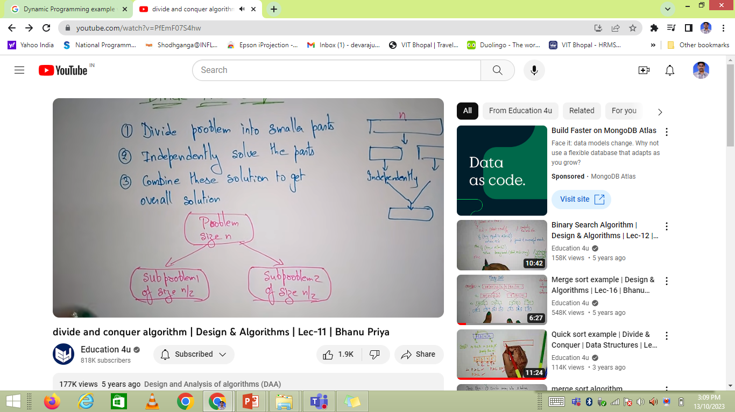
Divide-and-Conquer

Slide 152
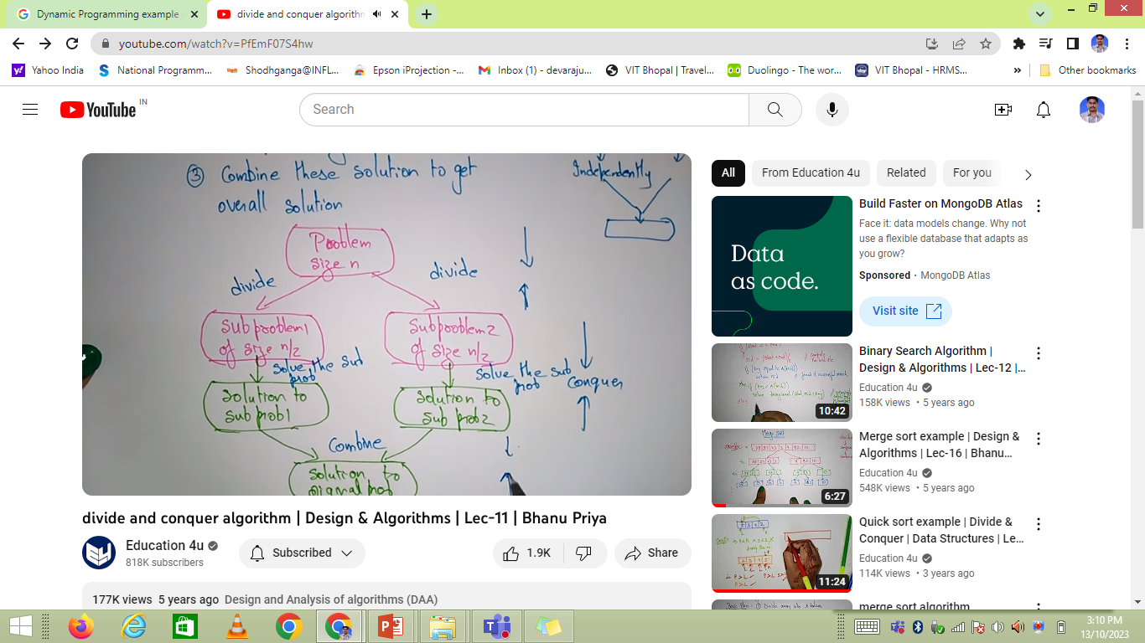
Divide-and-Conquer

Slide 153
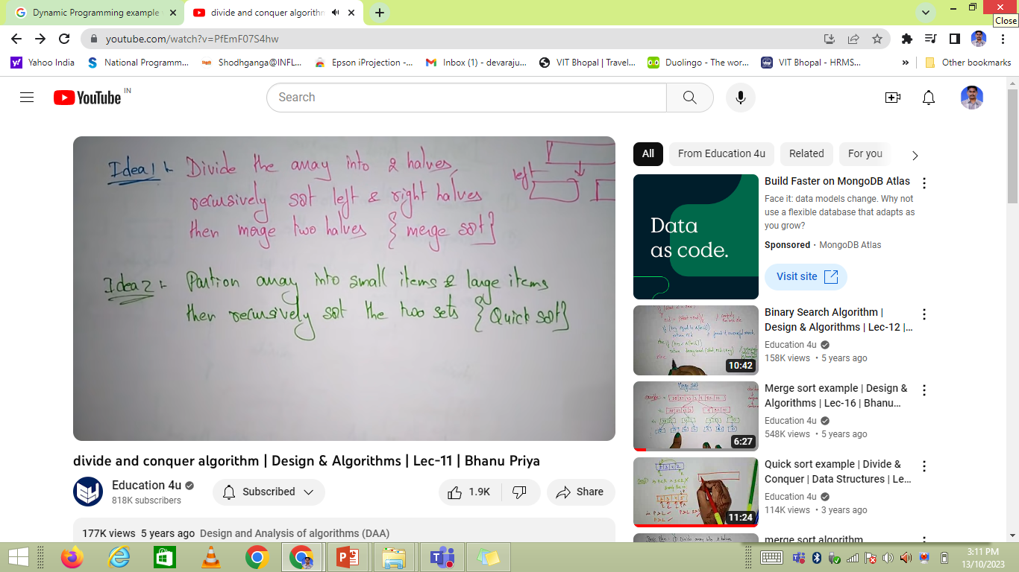
Divide-and-Conquer

Slide 154

Divide-and-Conquer

Slide 155
Divide-and-Conquer
Divide-and-conquer:
  Break the problem into smaller sub-problems
  Solve each of the sub-problems
  Combine the solutions to obtain the solution to the original problem
Key detail:
  We keep breaking the sub-problems into smaller and smaller, until the problem is transformed into something entirely different.
    – At this point, we “conquered” the original problem.

Slide 156
Divide-and-Conquer
Divide-and-conquer:
● Example: In the merge sort, we have the (complicated) task of sorting a bunch of values.
  – However, sorting a set of one value, however, is a
  completely different problem (a trivial one, in this case).
  – Sorting a set of two values is not as trivial, but it's still a completely different problem — one that can be
  described as one conditional swap.

Slide 157
Divide-and-Conquer
Divide-and-conquer:
An interesting example that we have not covered earlier in the course: Karatsuba multiplication algorithm:
– Useful for multiplying polynomials and integer number (based on a binary representation)
Originally proposed as an efficient technique to implement binary multiplication in hardware (i.e., an efficient design of the multiplication circuitry in an ALU)

Slide 158
Divide-and-Conquer
Divide-and-conquer:
The key detail in this case being: multiplying two numbers of n bits is a complicated problem — but multiplying two single-bit numbers is just a logical AND gate.
The algorithm is nowadays used in cryptographic applications (among others), where arithmetic with very large numbers (in the order of up to thousands of bits) is required:
  – In this context, the difference being: multiply a number of n bits where n > CPU register width vs. multiply two register-size numbers.

Slide 159
Greedy Algorithms

Slide 160

Greedy Algorithms

Slide 161


Greedy Algorithms

Slide 162

Greedy Algorithms

Slide 163

Greedy Algorithms

Slide 164
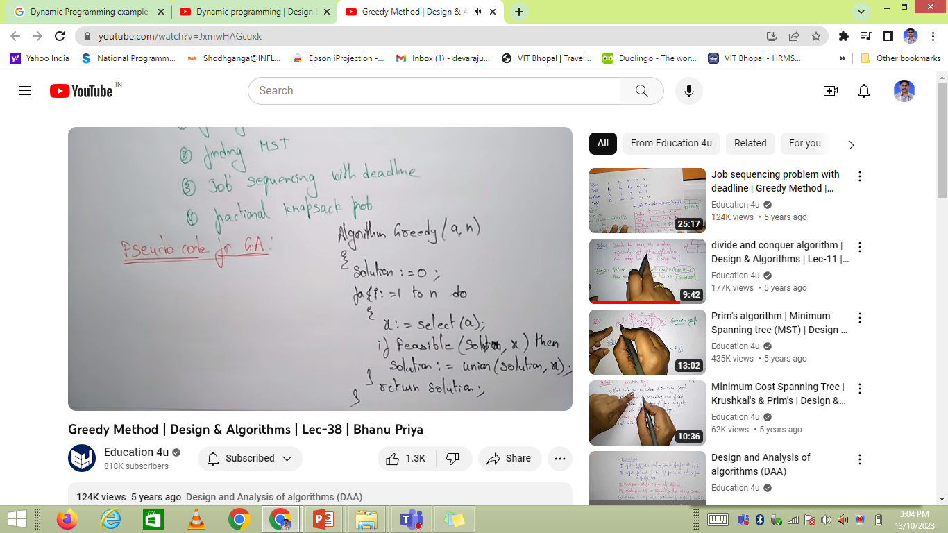
Greedy Algorithms

Slide 165
Greedy Algorithms
  These are iterative algorithms that at each iteration the criterion used is to maximize some “gain” or some objective function.
  The term “greedy” refers to the fact that the algorithms do this in a “short sighted” way; they try to maximize immediate gain, disregarding the big picture (“get the most I can get now ”).
    – For this reason, they can fail to determine a global maximum or minimum (they could “fall in a trap” and
    converge to some local maximum)
    – Example: finding the maximum of a function going by
    steps of fixed size. (example drawn in the board)
Dijkstra's, Prim's, and Kruskal's algorithms are all greedy algorithms

Slide 166
Greedy Algorithms
  The development of a greedy algorithm can be separated into the following steps:
    Cast the optimization problem as one in which we make a choice and are left with one subproblem to solve.
    Prove that there is always an optimal solution to the original problem that makes the greedy choice, so that the greedy choice is always safe.
    Demonstrate that, having made the greedy choice, what remains is a subproblem with the property that if we combine an optimal solution to the subproblem with the greedy choice that we have made, we arrive at an optimal solution to the original problem.

Slide 167
Greedy-Choice Property
  The greedy choice property is that a globally optimal solution can be arrived at by making a locally optimal (=greedy) choice.

Slide 168
Optimal Substructure
  A problem exhibits optimal substructure if and only if an optimal solution to the problem contains within it optimal solutions to subproblems.

Slide 169
Optimal Substructure
  A classical example of this technique is the problem of producing change — or in general, expressing a given amount of money in coins, minimizing the number of coins required.
  What's a greedy algorithm to compute this result?
  At each iteration, put as many coins of the highest denomination that fits (so that at this iteration we minimize the number of coins used).
    – But.... Does it minimize the number of coins in the final outcome of the algorithm?

Slide 170
Optimal Substructure
You're probably used to the idea that it does (because with Canadian coins / denominations, it does work)
But it can indeed fail. Consider denominations 10, 8, and 1; and try to break 17 into those.
The optimal is obviously 3 coins (2×8 + 1); but the greedy algorithm would tell us that we require 8 coins! (10 + 7×1)

Slide 171
Optimal Substructure
The greedy algorithm can work (as in, produce always the correct output), depending on the set of denominations:
  If every denomination is at least twice the next one (“next one” in decreasing order, that is).
  Alternatively, if every denomination is greater than or equal to the sum of all smaller denominations.
    – Canadian coins meet these requirements; in cents, we have: 200, 100, 25, 10, 5, and 1

Slide 172
Optimal Substructure
So, if these greedy / short-sighted algorithms can fail, why do we bother? Why are they attractive?
They tend to be efficient — at each iteration, we look only at the immediate scenario, no need to look globally.
If we can find a greedy algorithm that works, then that's good news!
  – On the other hand, it could be an example of a solution to a problem like an NP-complete problem, or a problem believed intractable, and a greedy algorithm might be an efficient alternative that finds a near-optimal solution.

Slide 173
Backtracking algorithms

Slide 174
Backtracking algorithms
Backtracking algorithms can be seen as an optimized form of exhaustive search algorithms:
  Try all possible combinations of things, with early elimination of paths that lead to no solution.
  A good visual analogy is: Think of the possibilities represented by a tree, and we do a depth-first traversal, but we have the advantage that in many cases, before reaching the leaf node, we'll know that this path will lead us nowhere, so we just “backtrack” and try the next possibility at the previous level.

Slide 175
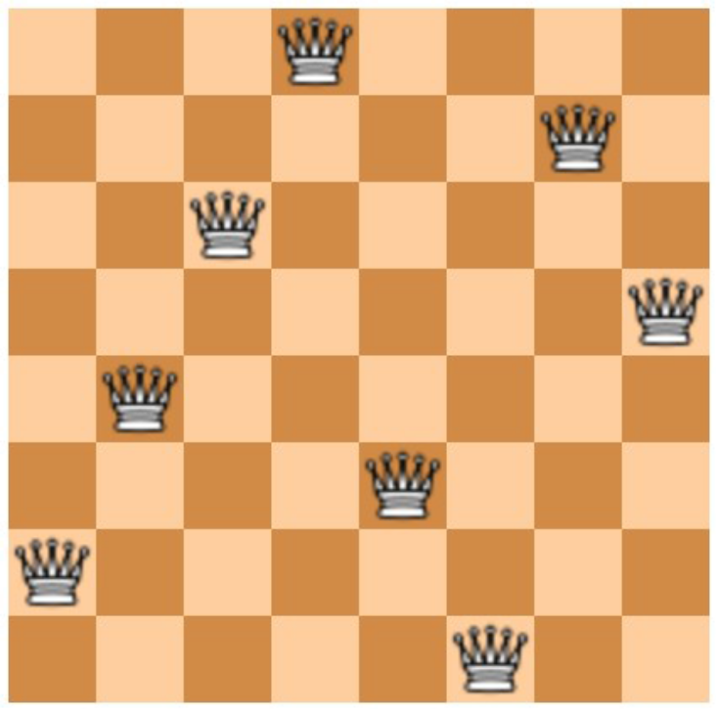
Backtracking algorithms
One classical example is the famous eight queens Chess puzzle:
  Find a placement for eight queens in a chess board such that neither one falls under threat of capture.

Slide 176
Backtracking algorithms
A backtracking algorithm places one queen at a time (say, column by column).
  At each column (each “level” of the search), we have eight possibilities, so we try one and move to the next level.
    – If at some level we find that all eight possibilities fail, then we backtrack — go back to the previous level, reporting that this one failed; at the previous level, we now move to the next possibility and keep trying.
    – The key detail is that most of the time, we're going to
    discover early that the current path won't work (e.g., at
    the third or fourth column we'll find that it won't work)

Slide 177
Dynamic Programming

Slide 178

Dynamic Programming

Slide 179

Dynamic Programming

Slide 180

Dynamic Programming
Steps to design DP Algorithm:

Slide 181
Dynamic Programming
The basic idea with Dynamic programming is to work with a problem that is broken into slightly smaller sub-problems, where some of these sub-problems overlap.
  A straightforward recursive solution is inefficient since we solve the same sub-problems over and over again.
The main detail with a dynamic programming solution is that we store the solutions for sub ‑problems that we already solved!

Slide 182
Dynamic Programming
The development of a dynamic programming algorithm can be subdivided into the following steps:
  Characterize the structure of an optimal solution
  Recursively define the value of an optimal solution
  Compute the value of an optimal solution in a bottom-up fashion
  Construct an optimal solution from computed information

Slide 183
Dynamic Programming
A classical example is that of a recursive implementation of a function to determine a Fibonacci number — which can be “neatly” implemented as:
int fibonacci (int n)
{
if (n <= 2)
{
return 1;
}
return fibonacci(n−1) + fibonacci(n−2);
}

Slide 184
Dynamic Programming
Two approaches:
Top to bottom
  – Set up an associated array where each time that the function is requested to compute one value, it first checks if that value is in the corresponding location in the array:
    If it is, use the value
    If it's not, compute the value and store the obtained result in the array.
Bottom to top
  – Start at the “base case”, and explicitly go up, calculating the “upper” values in terms of the already-calculated “bottom” values.

Slide 185
Dynamic Programming
There are many applications. Examples are:
Finding the optimal order of multiplications for a sequence of matrices of different sizes
  – Matrix multiplication is associative; obtaining ABCD can be done as A(BCD), or (AB)(CD), or A(BC)D, etc.
  – When considering all possible arrangements, some of the arrangements for smaller sequences repeat, so we would end up redundantly doing these computations

Slide 186
Dynamic Programming
Finding common substrings, or aligning strings where differences are small omissions on either side.
Alignment by stretching sub-sequences:
  – This has very interesting applications in speech recognition and in rhythm recognition/matching for music search applications.

Slide 187
Key Question
When can we apply the dynamic programming paradigm?

Slide 188
Optimal Substructure
A problem exhibits optimal substructure if and only if an optimal solution to the problem contains within it optimal solutions to subproblems.
Whenever a problem exhibits optimal substructure, it is an indication that a dynamic programming or greedy strategy might apply.

Slide 189
Overlapping Subproblems
A second indication that dynamic programming might be applicable is that the space of subproblems must be small, meaning that a recursive algorithm for the problem solves the same subproblems over and over.
Typically, the total number of distinct subproblems is a polynomial in the input size.

Slide 190
Overlapping Subproblems
When a recursive algorithm revisits the same problem over and over again, then we say that the optimization problem has overlapping subproblems.
Here two subproblems are called overlapping if and only if they really are the same subproblem that occurs as a subproblem of different problems.

Slide 191
Note
If a recursive algorithm solving the problem creates always new subproblems, then this is an indication that divide-and-conquer methods rather than dynamic programming might apply.

Slide 192
END

